Slide 1

P peline
The Data
Byte 3
© Jennifer Mankoff
The Data Pipeline; HCII; Spring 2014

Slide 2
Introducing Byte 3
jmankoff-byte3.appspot.com
Same data set as Byte 2
Using a JavaScript visualization library
Passing data from your python code to JavaScript running in the user's browser
Designing a visualization of your data

Slide 3
What is D3?
http://techslides.com/over-2000-d3-js-examples-and-demos/
http://bl.ocks.org/mbostock

Slide 4
D3 Uses Web Standards
D3 = Data-Driven Documents
Uses:
HTML (sometimes) + SVG (vector graphics for the web) for content
<!DOCTYPE html> <meta charset="utf-8”> <body>
<svg width="960" height="500”> <text y="12”> Hello, world! </text> </svg>
</body>
Notes:
----- Meeting Notes (2/6/14 09:50) -----
missing body here

Slide 5
D3 Uses Web Standards
D3 = Data-Driven Documents
Uses:
HTML + SVG for content
CSS for aesthetics
<!DOCTYPE html> <meta charset="utf-8”>
<style> body { background: steelblue; } </style>

Slide 6
CSS Selections
Body is a reference to parts of your html
body { background: steelblue; }
You can use other options
#rect
rect
.rect
[color=red]
color red
rect.rounded
rect#rounded
<any id=“rect”>
<rect>
<any class=“rect”>
<any color=“red”>
<color><red></color>
<rect class=“rounded”>
<rect id=“rounded”>

Slide 7
Example use of CSS in Byte3
rect:hover {
fill: orange;
}

Slide 8
D3 Uses Web Standards
D3 = Data-Driven Documents
Uses:
HTML + SVG for content
CSS for aesthetics
JavaScript for interaction
Interoperate seamlessly through manipulating the Document Object Model
Great debugging support in browsers

Slide 9
Using D3
<!DOCTYPE html> <meta charset="utf-8”> <style>/* CSS */</style>
<body> <script src="d3.v2.js"></script> <script>/* JavaScript */</script>
</body>

Slide 10
Setting up an axis
// collect data from Python
var x_labels = {{x_labels|safe}}

Slide 11
Setting up an axis
Tells javascript not to escape any characters (the data is already ‘safe’)
// collect data from Python
var x_labels = {{x_labels|safe}}

Slide 12
Setting up an axis
// collect data from Python
var x_labels = {{x_labels|safe}}
// set up the x axis scale to go from 0 to width
var x_scale = d3.scale.ordinal()
.rangeRoundBands([0, width], .1);
Notes:
----- Meeting Notes (2/6/14 09:50) -----
change x to x_scale

Slide 13
Setting up an axis
Range is the range of the axis in svg coordinates rangeRoundBands sets up the bar width with no fractional pixels, and the .1 is the distance between bars
// collect data from Python
var x_labels = {{x_labels|safe}}
// set up the x axis scale to go from 0 to width
var x_scale = d3.scale.ordinal()
.rangeRoundBands([0, width], .1);

Slide 14
Setting up an axis
// collect data from Python
var x_labels = {{x_labels|safe}}
// set up the x axis scale to go from 0 to width
var x_scale = d3.scale.ordinal()
.rangeRoundBands([0, width], .1);
// associate the axis with the labels
x_scale.domain(x_labels);
Domain is the stuff that has to be mapped onto the range (x_labels in this case)

Slide 15
Setting up an axis
// create the x axis
var xAxis = d3.svg.axis()
.scale(x_scale)
.orient("bottom");

Slide 16
Setting up an axis
// create the x axis
var xAxis = d3.svg.axis()
.scale(x_scale)
.orient("bottom");
Now we can pass that axis to d3’s axis drawing code

Slide 17
Setting up an axis
// create the x axis
var xAxis = d3.svg.axis()
.scale(x_scale)
.orient("bottom");
// create the drawing area
var svg = d3.select("body").append("svg”)
// we need to account for margins 'by hand'
.attr("width", width + margin.left + margin.right)
.attr("height", height + margin.top + margin.bottom);

Slide 18
Setting up an axis
Append adds something to a selection (you could add an ‘h1’ (to body), a ‘circle’ (to an svg), and so on. append returns a new selection!
// create the x axis
var xAxis = d3.svg.axis()
.scale(x_scale)
.orient("bottom");
// create the drawing area
var svg = d3.select("body").append("svg”)
// we need to account for margins 'by hand'
.attr("width", width + margin.left + margin.right)
.attr("height", height + margin.top + margin.bottom);

Slide 19
Setting up an axis
// create the x axis
var xAxis = d3.svg.axis()
.scale(x_scale)
.orient("bottom");
// create the drawing area
var svg = d3.select("body").append("svg”)
// we need to account for margins 'by hand'
.attr("width", width + margin.left + margin.right)
.attr("height", height + margin.top + margin.bottom);
D3 uses chained function calls e.g. to apply attributes to the current selection (which is the svg returned by append)

Slide 20
Setting up an axis
// draw the x axis (D3 handles the details in '.call')
svg.append("g")
.attr("class", "x axis")
.attr("transform", "translate(0," + height + ")")
.call(xAxis);
This ensures that everything that’s drawn by xAxis is translated to the bottom of the svg

Slide 21
Simple Example: Scatterplot
var data = [
{x: 10.0, y: 9.14},
{x: 8.0, y: 8.14},
{x: 13.0, y: 8.74},
{x: 9.0, y: 8.77},
{x: 11.0, y: 9.26}
];
Credits: http://bost.ocks.org/mike/d3/workshop/#40

Slide 22
Mapping Data to DOM Elements
svg.selectAll("circle")
.data(data)
.enter().append("circle")
.attr("cx", function x(d) {return d.x;})
.attr("cy", function y(d) {return d.y;})
.attr("r", 2.5);
Credits: http://bost.ocks.org/mike/d3/workshop/#40

Slide 23
Mapping Data to DOM Elements
svg.selectAll("circle")
.data(data)
.enter().append("circle")
.attr("cx", function x(d) {return d.x;})
.attr("cy", function y(d) {return d.x;})
.attr("r", 2.5);
This use of selectAll specifies that the contents of data should map onto any circles in the svg
Credits: http://bost.ocks.org/mike/d3/workshop/#40

Slide 24
Mapping Data to DOM Elements
svg.selectAll("circle")
.data(data)
.enter().append("circle")
.attr("cx", function x(d) {return d.x;})
.attr("cy", function y(d) {return d.x;})
.attr("r", 2.5);
BUT!!!! The circles don’t exist yet. You’re just telling d3 that when they do they should correspond to data
Credits: http://bost.ocks.org/mike/d3/workshop/#40

Slide 25
Mapping Data to DOM Elements
svg.selectAll("circle")
.data(data)
.enter().append("circle")
.attr("cx", function x(d) {return d.x;})
.attr("cy", function y(d) {return d.x;})
.attr("r", 2.5);
(for each data point; implicitly)
enter() creates the missing circle and returns it
Credits: http://bost.ocks.org/mike/d3/workshop/#40

Slide 26
Mapping Data to DOM Elements
svg.selectAll("circle")
.data(data)
.enter().append("circle")
.attr("cx", function x(d) {return d.x;})
.attr("cy", function y(d) {return d.x;})
.attr("r", 2.5);
This tells enter() what to create. enter() adds it to the parent node (the svg in this case)
Credits: http://bost.ocks.org/mike/d3/workshop/#40

Slide 27
Mapping Data to DOM Elements
That implicit for loop binds ‘d’ to the current piece of data. Here we retrieve d’s x value and y value.
svg.selectAll("circle")
.data(data)
.enter().append("circle")
.attr("cx", function x(d) {return d.x;})
.attr("cy", function y(d) {return d.y;})
.attr("r", 2.5);
Credits: http://bost.ocks.org/mike/d3/workshop/#40
Notes:
----- Meeting Notes (2/6/14 09:50) -----
change d.x to d.y in the second case

Slide 28
What data do we need?
Coming from Python:
[{'Foster': 0, 'Returned to Owner': 0, 'Age': '<6mo', 'Adopted': 0, 'Euthanized': 0, 'Other': 0, 'Transferred to Rescue Group': 0}, {'Foster': 0, 'Returned to Owner': 0, 'Age': '6mo-1yr', 'Adopted': 0, 'Euthanized': 0, 'Other': 0, 'Transferred to Rescue Group': 0} ,…]

Slide 29
Transformed for easy display
data.forEach(function(d) {
// the y0 position (lowest position) for the stacked bars var y0 = 0;
// Calculate a y position for each of the bars d.outcomes = y_labels.map(function(name) {
// each outcome has a name, a y0 position (it's bottom), // and a y1 position (it's top). res = {name: name, y0: y0, y1: y0 + d[name]};
// and we also have to update y0 for the next rectangle. y0 = y0 + d[name];
return res;});
d.total = d.outcomes[d.outcomes.length - 1].y1;
});

Slide 30
Transformed for easy display
Loops through each age in the array passed over from python
data.forEach(function(d) {
// the y0 position (lowest position) for the stacked bars var y0 = 0;
// Calculate a y position for each of the bars d.outcomes = y_labels.map(function(name) {
// each outcome has a name, a y0 position (it's bottom), // and a y1 position (it's top). res = {name: name, y0: y0, y1: y0 + d[name]};
// and we also have to update y0 for the next rectangle. y0 = y0 + d[name];
return res;});
d.total = d.outcomes[d.outcomes.length - 1].y1;
});

Slide 31
Transformed for easy display
data.forEach(function(d) {
// the y0 position (lowest position) for the stacked bars var y0 = 0;
// Calculate a y position for each of the bars d.outcomes = y_labels.map(function(name) {
// each outcome has a name, a y0 position (it's bottom), // and a y1 position (it's top). res = {name: name, y0: y0, y1: y0 + d[name]};
// and we also have to update y0 for the next rectangle. y0 = y0 + d[name];
return res;});
d.total = d.outcomes[d.outcomes.length - 1].y1;
});
The y0 position for the first bar for this age is 0

Slide 32
Transformed for easy display
data.forEach(function(d) {
// the y0 position (lowest position) for the stacked bars var y0 = 0;
// Calculate a y position for each of the bars d.outcomes = y_labels.map(function(name) {
// each outcome has a name, a y0 position (it's bottom), // and a y1 position (it's top). res = {name: name, y0: y0, y1: y0 + d[name]};
// and we also have to update y0 for the next rectangle. y0 = y0 + d[name];
return res;});
d.total = d.outcomes[d.outcomes.length - 1].y1;
});
Loop through all of the possible outcome names (which are stored in y_labels)

Slide 33
Transformed for easy display
data.forEach(function(d) {
// the y0 position (lowest position) for the stacked bars var y0 = 0;
// Calculate a y position for each of the bars d.outcomes = y_labels.map(function(name) {
// each outcome has a name, a y0 position (it's bottom), // and a y1 position (it's top). res = {name: name, y0: y0, y1: y0 + d[name]};
// and we also have to update y0 for the next rectangle. y0 = y0 + d[name];
return res;});
d.total = d.outcomes[d.outcomes.length - 1].y1;
});
Loop through all of the possible outcome names (which are stored in y_labels)

Slide 34
Transformed for easy display
data.forEach(function(d) {
// the y0 position (lowest position) for the stacked bars var y0 = 0;
// Calculate a y position for each of the bars d.outcomes = y_labels.map(function(name) {
// each outcome has a name, a y0 position (it's bottom), // and a y1 position (it's top). res = {name: name, y0: y0, y1: y0 + d[name]};
// and we also have to update y0 for the next rectangle. y0 = y0 + d[name];
return res;});
d.total = d.outcomes[d.outcomes.length - 1].y1;
});
Create a dictionary containing the name, y0 and y1 position of the outcome
Notes:
// we add a new array (d.outcomes) with information about every sub-bar's
// y0 and y1 position for that age; and a new value (d.total) with
// information about the total height of the stacked bar
// y labels. This runs function(name) once for each y label (name is the current label)
// and stores each resulting dictionary in the array d.outcomes

Slide 35
Transformed for easy display
data.forEach(function(d) {
// the y0 position (lowest position) for the stacked bars var y0 = 0;
// Calculate a y position for each of the bars d.outcomes = y_labels.map(function(name) {
// each outcome has a name, a y0 position (it's bottom), // and a y1 position (it's top). res = {name: name, y0: y0, y1: y0 + d[name]};
// and we also have to update y0 for the next rectangle. y0 = y0 + d[name];
return res;});
d.total = d.outcomes[d.outcomes.length - 1].y1;
});
y0 is already ‘known’, y1 is y0 plus the number of dogs for this outcome (d[name])

Slide 36
Transformed for easy display
data.forEach(function(d) {
// the y0 position (lowest position) for the stacked bars var y0 = 0;
// Calculate a y position for each of the bars d.outcomes = y_labels.map(function(name) {
// each outcome has a name, a y0 position (it's bottom), // and a y1 position (it's top). res = {name: name, y0: y0, y1: y0 + d[name]};
// and we also have to update y0 for the next rectangle. y0 = y0 + d[name];
return res;});
d.total = d.outcomes[d.outcomes.length - 1].y1;
});
Here we update y0 so that it will be correct on the next iteration of the loop.

Slide 37
Transformed for easy display
data.forEach(function(d) {
// the y0 position (lowest position) for the stacked bars var y0 = 0;
// Calculate a y position for each of the bars d.outcomes = y_labels.map(function(name) {
// each outcome has a name, a y0 position (it's bottom), // and a y1 position (it's top). res = {name: name, y0: y0, y1: y0 + d[name]};
// and we also have to update y0 for the next rectangle. y0 = y0 + d[name];
return res;});
d.total = d.outcomes[d.outcomes.length - 1].y1;
});
The final step copies the y1 from the very last bar into d.total (the total height of this age’s bar)

Slide 38
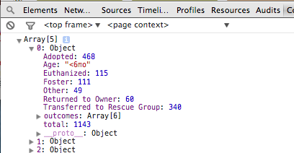
The result:

Slide 39
Creating Stacked Bars
// The selection '.age' will correspond to the data
var age = svg.selectAll(".Age")
.data(data)
.enter().append("g")
.attr("class", "g")
.attr("x_position", function (d) {return x_scale(d.Age);})
.attr("transform", function(d) {return "translate(" + x_scale(d.Age) + ",0)"; });

Slide 40
Example from Byte3: Stacked Bars
// The selection '.age' will correspond to the data
var age = svg.selectAll(".Age")
.data(data)
.enter().append("g")
.attr("class", "g")
.attr("x_position", function (d) {return x_scale(d.Age);})
.attr("transform", function(d) {return "translate(" + x_scale(d.Age) + ",0)"; });
We want to create a group (“g”) for each age (since it will hold multiple bars)

Slide 41
Example from Byte3: Stacked Bars
// The selection '.age' will correspond to the data
var age = svg.selectAll(".Age")
.data(data)
.enter().append("g")
.attr("class", "g")
.attr("x_position", function (d) {return x_scale(d.Age);})
.attr("transform", function(d) {return "translate(" + x_scale(d.Age) + ",0)"; });
And our x axis mapper can calculate the x position of this group

Slide 42
Example from Byte3: Stacked Bars
// The selection '.age' will correspond to the data
var age = svg.selectAll(".Age")
.data(data)
.enter().append("g")
.attr("class", "g")
.attr("x_position", function (d) {return x_scale(d.Age);})
.attr("transform", function(d) {return "translate(" + x_scale(d.Age) + ",0)"; });
Which we stored in the previous line, and use to move this group to x, 0 here

Slide 43
Example from Byte3: Stacked Bars
age.selectAll("rect")
// join the outcome data for that age to each rectangle .data(function(d) { return d.outcomes; })
// the call to enter() creates the elements and binds them .enter().append("rect”) .attr("width", x_scale.rangeBand()) .attr("y", function(d) { return y_scale(d.y1); }) .attr("height", function(d) { return y_scale(d.y0) – y_scale(d.y1); })
// use the color scale to determine the fill color .attr("fill", function(d) { return color(d.name); })

Slide 44
Example from Byte3: Stacked Bars
age.selectAll("rect")
// join the outcome data for that age to each rectangle .data(function(d) { return d.outcomes; })
// the call to enter() creates the elements and binds them .enter().append("rect”) .attr("width", x.rangeBand()) .attr("y", function(d) { return y_scale(d.y1); }) .attr("height", function(d) { return y_scale(d.y0) – y_scale(d.y1); })
// use the color scale to determine the fill color .attr("fill", function(d) { return color(d.name); })
Creates a rectangle within the age group for each item in d.outcomes

Slide 45
Example from Byte3: Stacked Bars
age.selectAll("rect")
// join the outcome data for that age to each rectangle .data(function(d) { return d.outcomes; })
// the call to enter() creates the elements and binds them .enter().append("rect”) .attr("width", x.rangeBand()) .attr("y", function(d) { return y_scale(d.y1); }) .attr("height", function(d) { return y_scale(d.y0) – y_scale(d.y1); })
// use the color scale to determine the fill color .attr("fill", function(d) { return color(d.name); })
The width of each rectangle is identical (and provided by the x scale)

Slide 46
Example from Byte3: Stacked Bars
age.selectAll("rect")
// join the outcome data for that age to each rectangle .data(function(d) { return d.outcomes; })
// the call to enter() creates the elements and binds them .enter().append("rect”) .attr("width", x.rangeBand()) .attr("y", function(d) { return y_scale(d.y1); }) .attr("height", function(d) { return y_scale(d.y0) – y_scale(d.y1); })
// use the color scale to determine the fill color .attr("fill", function(d) { return color(d.name); })
The top of the bar is at d.y1

Slide 47
Example from Byte3: Stacked Bars
age.selectAll("rect")
// join the outcome data for that age to each rectangle .data(function(d) { return d.outcomes; })
// the call to enter() creates the elements and binds them .enter().append("rect”) .attr("width", x.rangeBand()) .attr("y", function(d) { return y_scale(d.y1); }) .attr("height", function(d) { return y_scale(d.y0) – y_scale(d.y1); })
// use the color scale to determine the fill color .attr("fill", function(d) { return color(d.name); })
And we calculate the height (could we have saved ourselves the effort and just stored height?

Slide 48
Example from Byte3: Stacked Bars
age.selectAll("rect")
// join the outcome data for that age to each rectangle .data(function(d) { return d.outcomes; })
// the call to enter() creates the elements and binds them .enter().append("rect”) .attr("width", x.rangeBand()) .attr("y", function(d) { return y_scale(d.y1); }) .attr("height", function(d) { return y_scale(d.y0) – y_scale(d.y1); })
// use the color scale to determine the fill color .attr("fill", function(d) { return color(d.name); })
Color is provided by the color scale

Slide 49
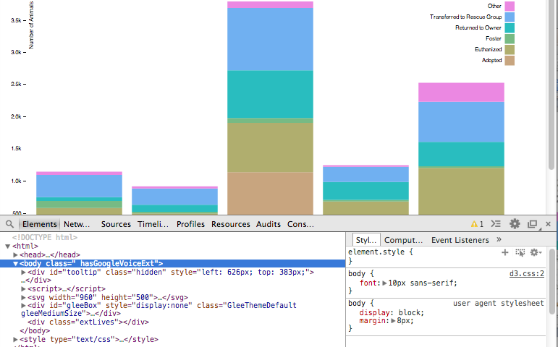
Debugging
Option-Command-I : Developer Tools in Chrome
Option-Command J : JavaScript Console

Slide 50
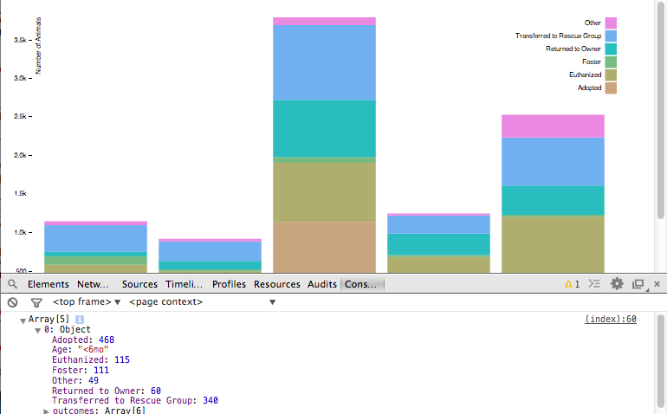
Debugging
Option-Command-I : Developer Tools in Chrome
Option-Command J : JavaScript Console

